Slide 1
Curve Modeling Bézier Curves

Slide 2
Introduction
A system that supports users to design curves must be:
Intuitive: We expect that every step.
Flexible: The system should provide the users with more control for designing and editing the shape of a curve.
Easy: The way of creating and editing a curve should be easy.

Slide 3
Introduction
Unified Approach: The way of representing, creating and editing different types of curves (e,g., lines, conic sections and cubic curves) must be the same.
Invariant: The represented curve will not change its geometry under geometric transformation (translation, rotation, …)

Slide 4
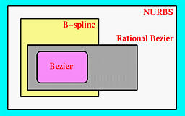
Introduction
If necessary, a user can add control points.
They are very geometric, intuitive.
The transition from curve to surface will not cause much difficulty.

Slide 5
Bézier Curves

Slide 6
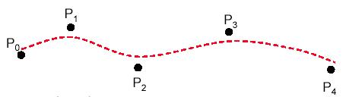
Bézier Curves
Bézier splines are:
spline approximation method;
useful and convenient for curve and surface design;
easy to implement;
available in Cad system, graphic package, drawing and painting packages.

Slide 7
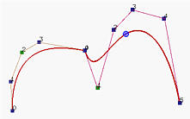
Bézier Curves
In general, a Bézier curve section can be fitted to any number of control points.
The number of control points to be approximated and their relative position determine the degree of the Bézier polynomial.

Slide 9

A Bezier curve is a parametric curve that uses Bernstein polynomial as a basis function/blending function.
Degree ‘n’ (order n+1) Bezier curve..

Slide 10
Blending Function

Slide 11
Let One Example!
Lets take 4 control point

Slide 12
Same way….

Slide 13
Now take consider coordinate x,y

Slide 14
Properties
of
Bézier ‍Curves

Slide 15
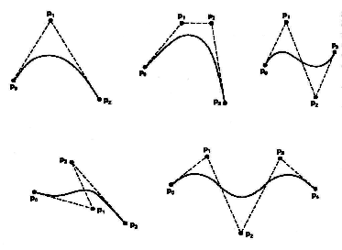
Properties of a Bézier ‍Curve
The degree of a Bézier curve defined by n+1 control points is n:
Parabola Curve
Cubic Curve
Cubic Curve
Cubic Curve

Slide 16
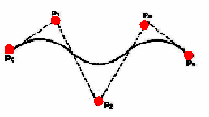
Properties of a Bézier ‍Curve
The curve passes though the first and the last control point C(u) passes through P₀ and P_{n}.

Slide 17
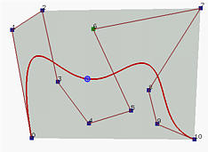
Properties of a Bézier Curve
The Bézier curve lies completely in the convex hull of the given control points.
Note that not all control points are on the boundary of the convex hull. For example, control points 3, 4, 5, 6, 8 and 9 are in the interior. The curve, except for the first two endpoints, lies completely in the convex hull.

Slide 18
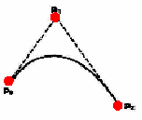
Properties of a Bézier ‍‍Curve
Moving control points:

Slide 19
Bézier Curves
The point that corresponds to t on the Bézier curve is the "weighted" average of all control points, where the weights are the coefficients B_{i,n}(t).

Slide 20
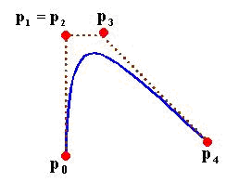
Design Techniques Using Bézier ‍Curve (Weights)
‍‍Multiple control points at a single coordinate position gives more weight to that position.

Slide 21
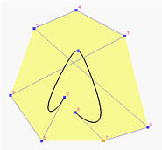
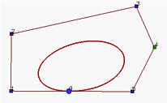
Design Techniques Using Bézier ‍Curve (Closed Curves)
‍‍Closed Bézier curves are generated by specifying the first and the last control points at the same position.
4
5
3
2
0
8
6
1
7
‍‍Note: Bézier curves are polynomials which cannot represent circles and ellipses.

Slide 22
Problem Solving
Constant Bezier curve for control points (4,2) (8,8) and (16,4)

Slide 23
Now We Know….

Slide 24
Problem Solving
Now consider X,Y coordinate

Slide 25
Now consider 3 control point..
(4,2) (8,8) and (16,4)

Slide 26
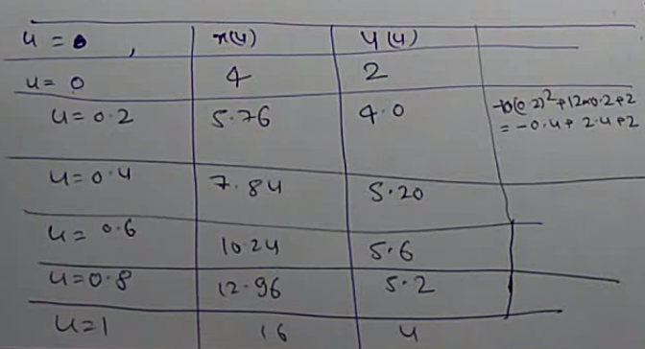
Now put t value into 3,4 equation

Slide 27
Now draw the curve…
Put the x,y value

